Slide 1

Coping with crises
Poland’s multiple EMU challenges
Performance, policies and perspectives
David Marsh, Chairman, OMFIF
Narodowy Bank Polski Academy
Warsaw, 22 October 2022

Slide 2
Poland and EMU – overall position
Hopes and illusions: The nature of EMU
CEE , UK and Germany compared
Living with crisis - EMU update
Precepts for the future

Slide 3
Poland and EMU – overall position

Slide 4
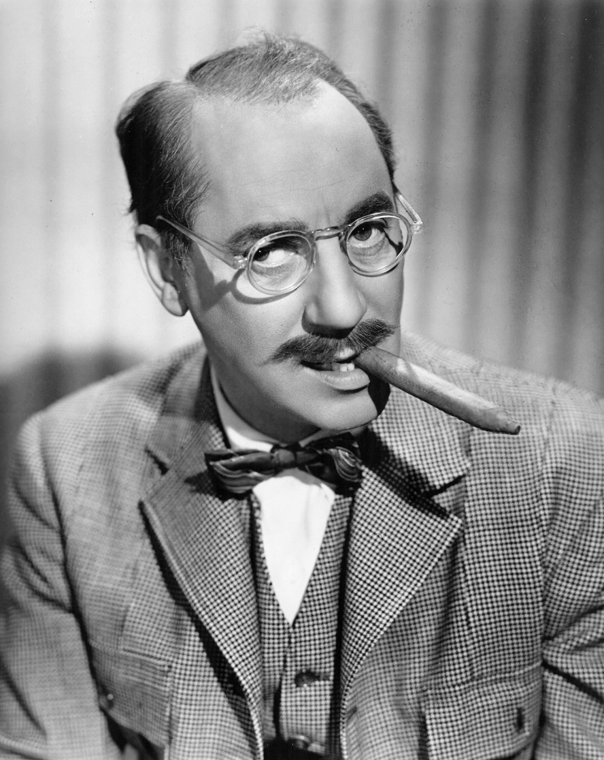
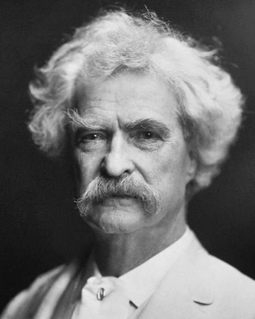
Two points of view
Groucho Marx
‘I wouldn’t want to join a club that would have me as a member.’
Mark Twain
‘Get your facts first, then you can distort them as you please.’

Slide 5
Poland’s share of EU GDP has doubled since 2004
EMU starts
EU Enlargement
Transatlantic Financial Crisis
Brexit referendum
Covid-19 starts
Poland’s EU GDP share: constant progression over 25 years
% annual . Source: Refinitv Eikon Datastream, Eurostat, national sources, OMFIF analysis. EU-28 GDP until 2019, EU-27 GDP + UK GDP from 2020.

Slide 6


POLAND
 | 2014 | 2015 | 2016 | 2017 | 2018 | 2019 | 2020 | 2021 | 2022f | 2023f
Real GDP (% change) | 3.4 | 4.2 | 3.1 | 4.8 | 5.4 | 4.7 | -2.2 | 5.9 | 3.8 | 0.5
GDP/capita ($ ‘000) | 14.3 | 12.6 | 12.4 | 13.9 | 15.5 | 15.7 | 15.8 | 17.9 | 19.0 | 20.0
Consumer price inflation (%) | 0.1 | -0.9 | -0.7 | 2.0 | 1.8 | 2.2 | 3.4 | 5.1 | 13.8 | 14.3
Unemployment (%) | 9.2 | 7.7 | 6.3 | 5.0 | 3.9 | 3.3 | 3.2 | 3.4 | 2.8 | 3.2
General government budget balance (% of GDP) | -3.7 | -2.6 | -2.4 | -1.5 | -0.2 | -0.7 | -6.9 | -1.9 | -4.1 | -3.1
General government gross debt (% of GDP) | 51.1 | 51.3 | 54.2 | 50.6 | 48.8 | 45.6 | 57.1 | 53.8 | 48.7 | 45.1
Current account balance (% of GDP) | -2.6 | -0.9 | -0.8 | -0.4 | -1.3 | 0.5 | 2.9 | -0.7 | -4.0 | -3.3
Source: IMF October 2022 WEO. Red / green: under- /outperformance cf. euro area; amber: equal scores
No comparisons for GDP/capita due to difficulties of aligning data with exchange rates and PPP calculations

Slide 7
Polish non-EMU status in national & EU interest
Poland’s GDP progress would have been impossible in EMU
Russia-Ukraine conflict confronts Poland with gravest test
CEE must live with geopolitical risk premium which may worsen
Currency flexibility & policy autonomy in stability framework
Improved budgetary performance relative to euro area
BUT far more needs to be done to curb fiscal spending
Inflation / current account has badly deteriorated – biggest task
Catch-up in living standards requires current account deficits
Attract investment, maintain high currency reserves
Economic priority: overcome funding impasse with EU

Slide 8
Series of interlinked conundrums
Legal obligation eventually to join euro
Two-thirds Sejm majority needed to change constitution
EMU did/can not resolve ‘birth defect’: lack of political union
Strategic Framework, National Euro Changeover Plan - 2010
National Euro Changeover Plan - 2011
Poland failing to meet most Maastricht criteria (inflation, ERM-II, interest rates, legislation), conforming on budget
Public opinion ambivalent, slight recent rise in euro popularity
Key external influences (fin. crisis, Greece, Russia-Ukraine)
EMU as Polish anchor? - Bedevilled by problems: no priority

Slide 9
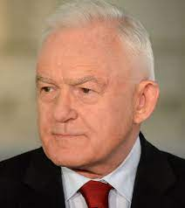
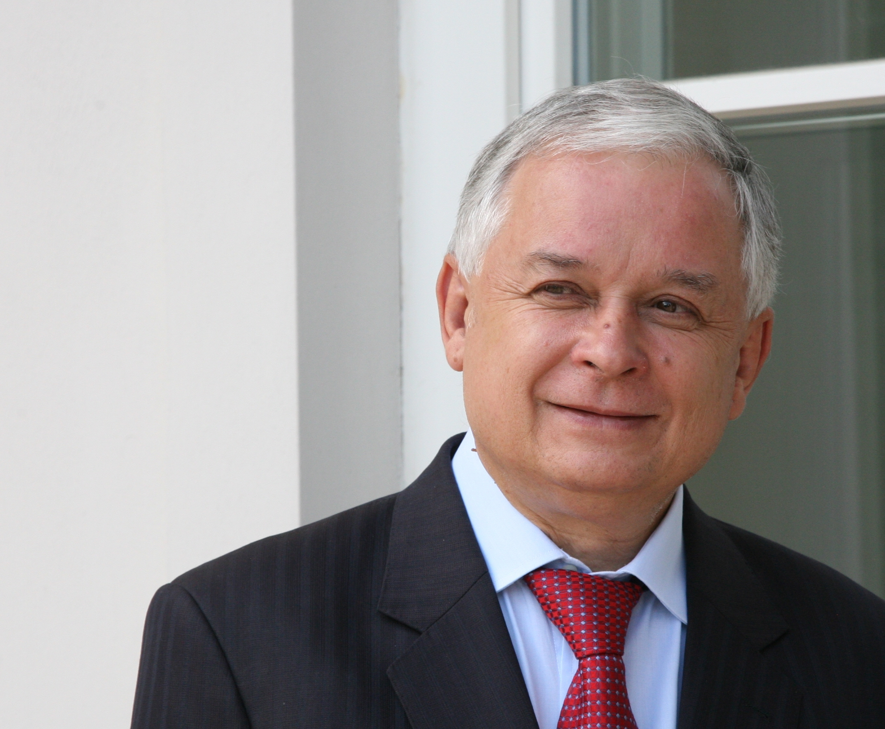
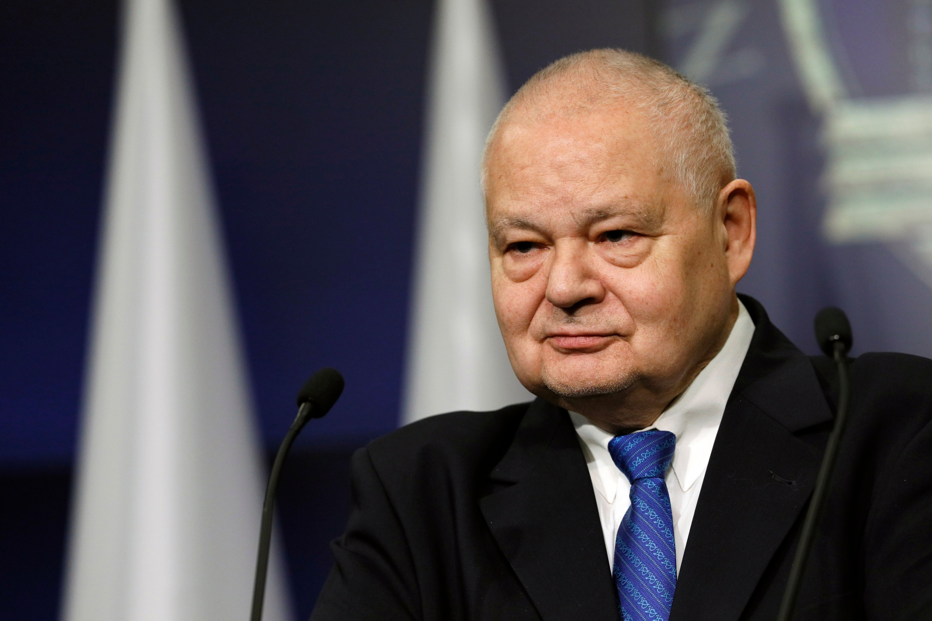
Challenge No 1: Devising a framework
Leszek Miller, Prime Minister
(2001-04)
Lech Kaczyński, President (2005-10)
Adam Glapiński, NBP President (2016- )
‘Poland should join euro between 2007 and 2009.’
- 2003
‘We need a referendum for Poland to join euro. ’
– 2008
‘The Polish authorities realised EMU imbalances were key reason for euro crisis. Warsaw has signalled no interest in joining in next 10 years. The EU knows it would be foolish to force a country to meet treaty obligations against the people’s will.’ – May 2017

Slide 10
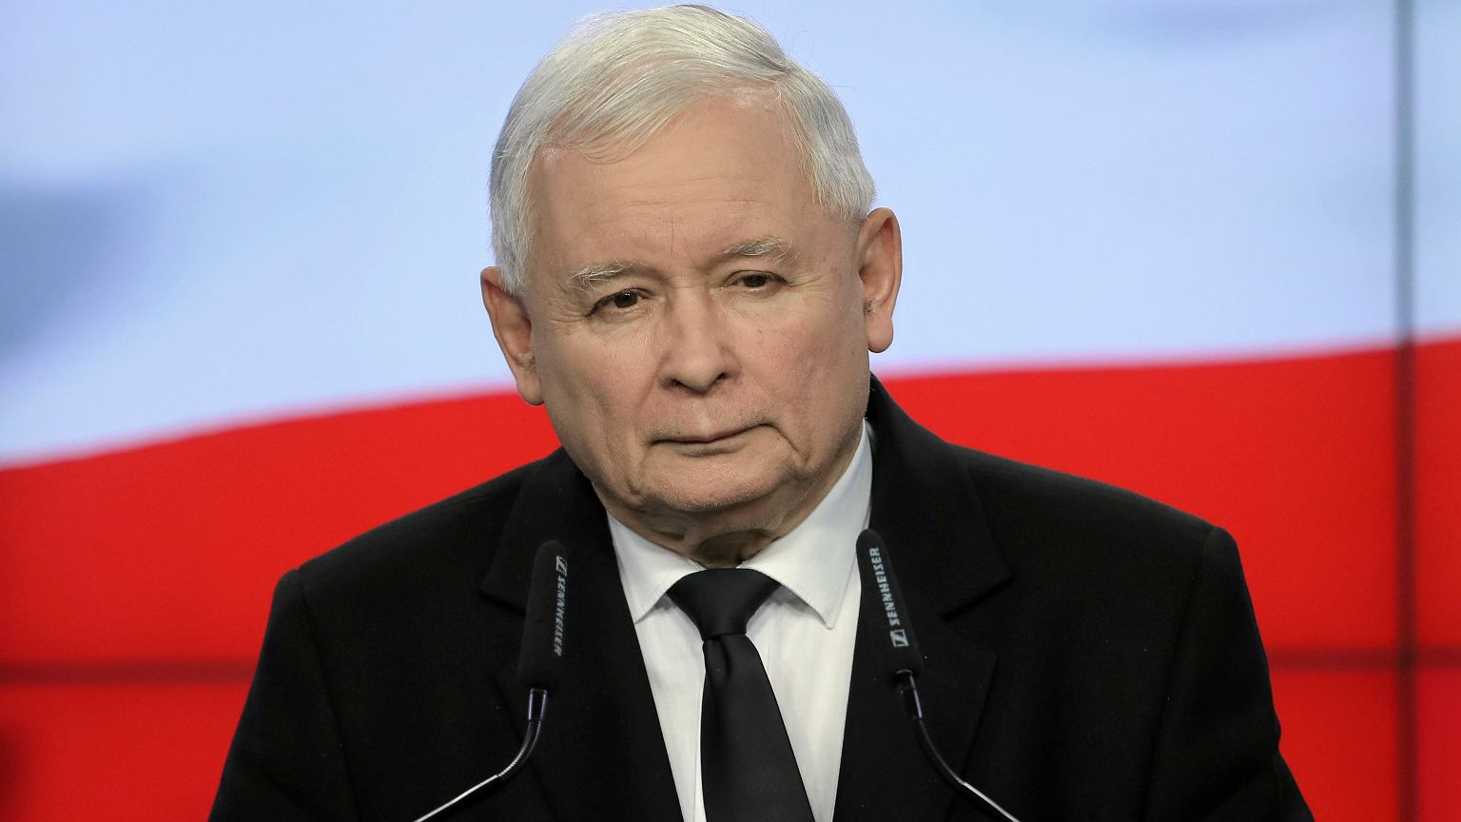
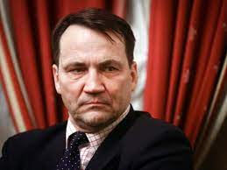
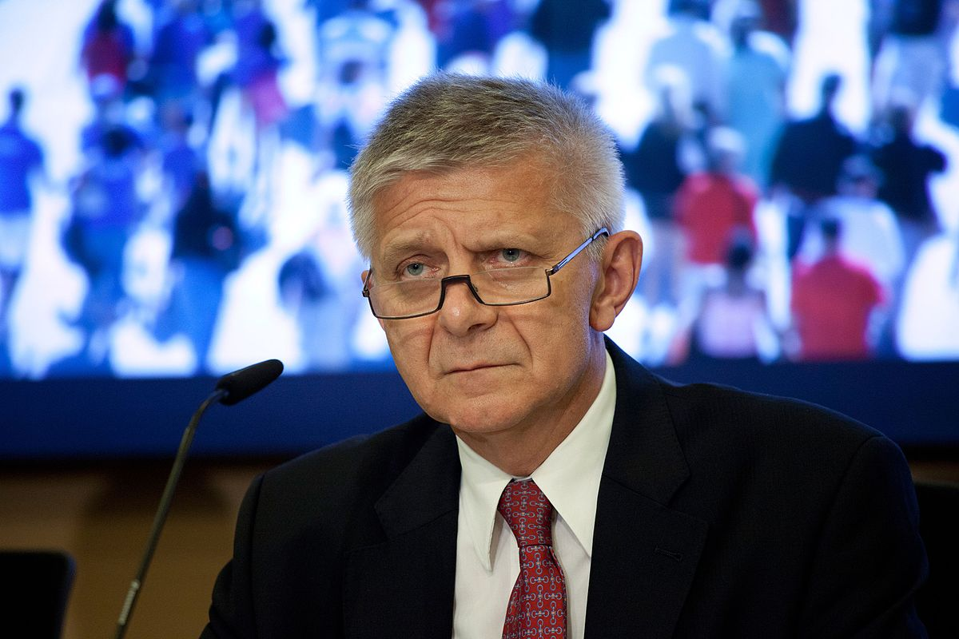
Challenge No 2 : Balancing solidarity & autonomy
Jaroslaw Kaczyński, Prime Minister (2006-07), current leader, Law & Justice Party
Radoslaw Sikorski , Foreign Minister (2007-14)
Marek Belka, NBP President, 2010-16
‘Poland aims to adopt the euro on 1 January 2016, but only if the eurozone is reformed by then, and entry is beneficial to us. The Polish government plans to comply with all the euro convergence criteria by 2015.’- 2011
‘Poland should demand to be permitted to adopt the euro without first joining the ERM-II due to concerns over currency speculation.’ - 2013
‘Adopting euro would raise prices and destabilise the zloty.’ - 2006..’

Slide 11
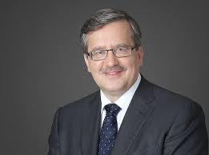
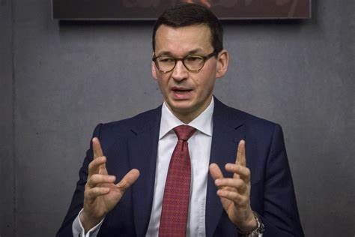
Challenge No 3 : Producing convergence
Bronislaw Komorowski, President (2010-15)
Jaroslaw Kaczyński, Prime Minister (2006-07), current leader, Law & Justice Party
Mateusz Morawiecki, Prime Minister (2017- )
‘Poland should make a decision after 2015. In the meantime it should seek to comply wth the convergence criteria.’ speculation.’ - 2013
‘We will adopt the euro when Poland’s economy catches up with others., when the economy reaches 85% of Germany’s GDP per capita .’ - 2019 ..’
‘Producing convergence with the euro area at this time would be harmful for Poland.`- 2019

Slide 12
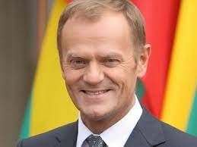
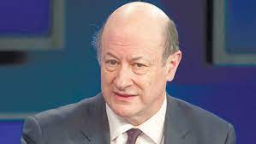
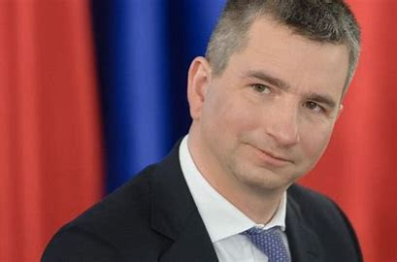
Challenge No 4: Balancing solidarity and autonomy
Donald Tusk, Prime Minister (2007-14)
Jacek Rostowski, Finance Minister 2007-13) - 2013
Mateusz Szczurek , Finance Minister (2013-15)
‘Poland should launch a national debate in 2013 on joining the euro’ – 2013
‘Poland has to carry out reform to prepare to join. We will not set a date for entry’ – 2013
‘Turbulence in the euro area has caused the Polish government to adopt another criterion for euro adoption – stabilisation of economic and monetary union.’ - 2013

Slide 13
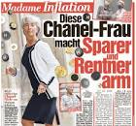
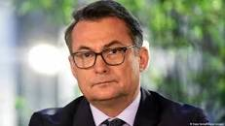
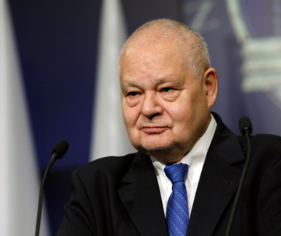
Challenge No 5: Restoring inflation credibility
Joachim Nagel, Bundesbank President (2022-)
Adam Glapiński, NBP President (2016- )
‘This Chanel Lady makes savers and pensioners poor’ – best-selling German daily Bild-Zeitung, October 2021, complaining about Christine Lagarde, ECB President
‘Further rate hikes are needed to return inflation to 2% – not just at the policy meeting at end-October. The ECB must not let up too soon. The longer inflation remains high, the greater the risk of above-target longer-term expectations. If inflation expectations de-anchored, interest rates would have to rise faster or higher.’ – October 2022
‘Inflation increased in September to 17.2%., due to strong rises in global energy and agricultural prices and earlier increases in energy tariffs, adding to core inflation. NBP tightening and the expected slowdown will support a decline in inflation towards the inflation target.’ – October 2022
Notes:
urther interest rate hikes will be needed to bring the inflation rate back to 2% in the medium term – not just at the monetary policy meeting at the end of October, in my opinion. The size of the interest rate steps and how high we raise interest rates will be driven in each case by the current data and their importance for the inflation outlook.
In any case, the ECB Governing Council must not let up too soon. Because we have to make sure that the high inflation ends. The longer inflation remains high, the greater the risk that longer-term inflation expectations will rise above the Eurosystem’s target. If inflation expectations were to de-anchor to the upside, interest rates would have to rise even faster or higher. And the macroeconomic costs of bringing inflation back down to the desired level would be higher as well. This is a scenario that we on the ECB Governing Council absolutely want to prevent.

Slide 14
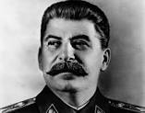

Challenge No 6 : Weighing geopolitics
Marek Belka, NBP President, (2010-16 )
Adam Glapiński, NBP President (2016- )
Joseph Stalin
‘The war in Ukraine is not an argument for Poland to join the common currency.’ – March 2022
‘How many divisions has the Pope? ‘
‘Poland may have to reevaluate its position on th euro after the Russian miltiary intervention in Ukraine.’ – 2014

Slide 15
II. Hopes and illusions: The nature of EMU

Slide 16
Objectives and outcomes of euro experiment
The five reasons for the euro
Underpin European Single Market by eliminating exchange risks, boost importance of European economy
Complete Franco-German post-war political rapprochement
Create a rival/complement to the dollar as world money
Shackle united Germany in a constructive European community
Build Europe’s global role – in politics, trade, economics and finance
Results have not lived up to expectations
Trade integration held up by poor macroeconomic picture
Franco-German ties weakened (Merkel-Sarkozy), bolstered by Brexit/ Russian war, fading (Scholz-Macron)
Dollar remains world's dominant currency, renminbi challenge hekd back in past five years
Germany still Europe’s uncertain leader, weakened by Russian miscalculations
Europe and UK both weakened by Brexit, becoming more dependent on US

Slide 17

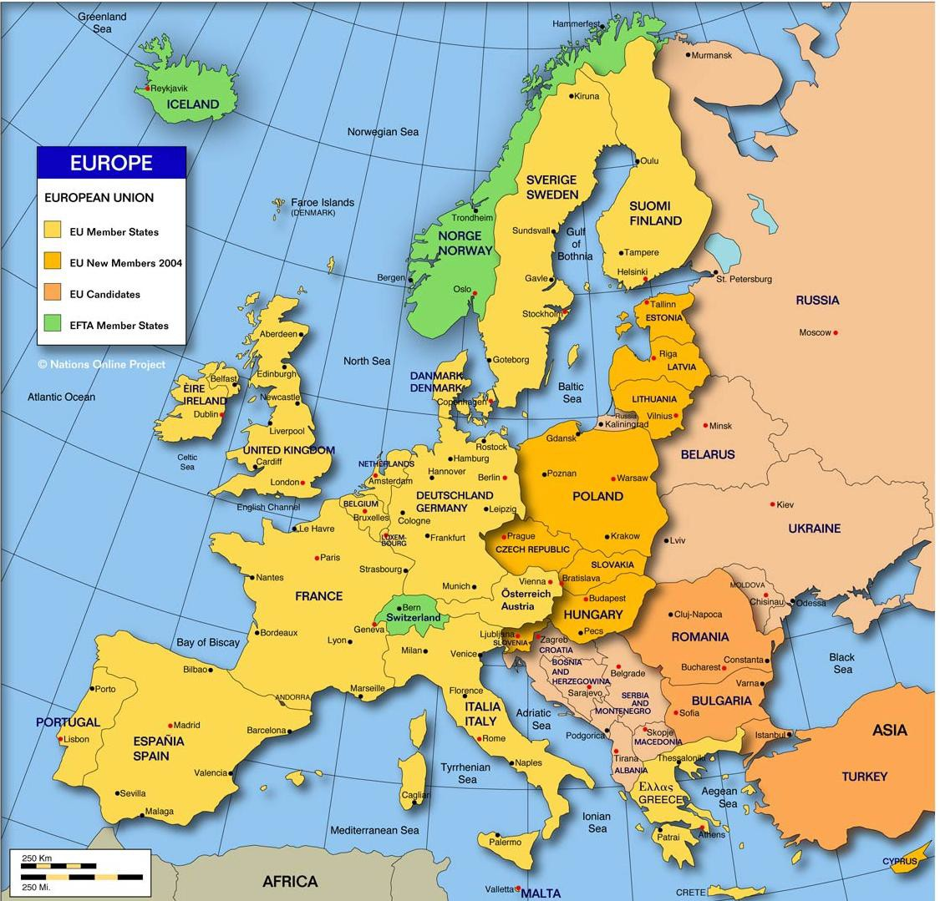
Motivations behind the euro
Goal No. 1 – Complete Europe’s single market
Jacques Delors
single currency for single market

Slide 18
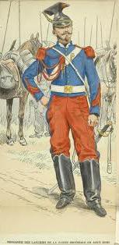
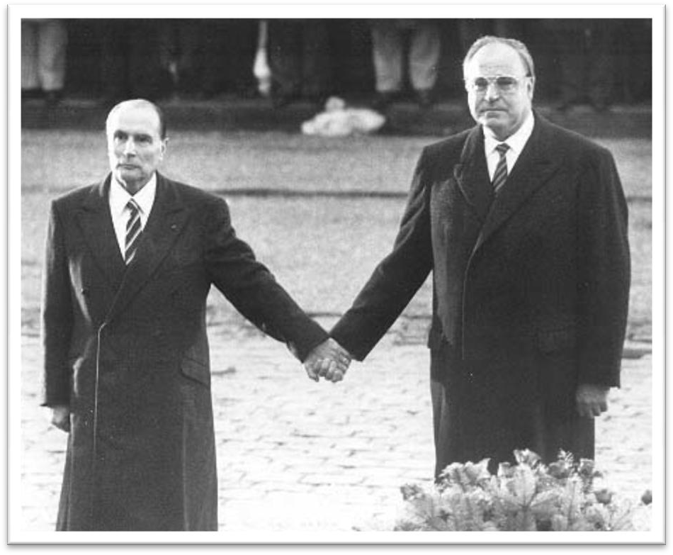
Motivations behind the euro
Goal No. 2 – Forge European political union
President Mitterrand, Chancellor Kohl,
eastern France, 1984
Franco-Prussian war 1870-71

Slide 19

Motivations behind the euro
Goal No. 3 – Provide rival for the dollar
Both France and Germany wanted in different ways to curb the dollar’s ‘exorbitant privilege’ permitting deficits ‘without tears’

Slide 20
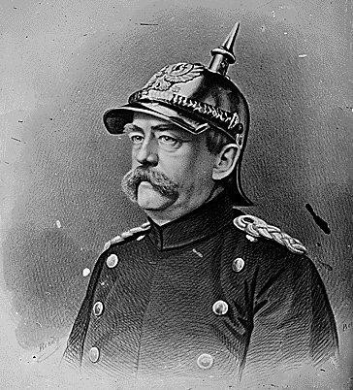
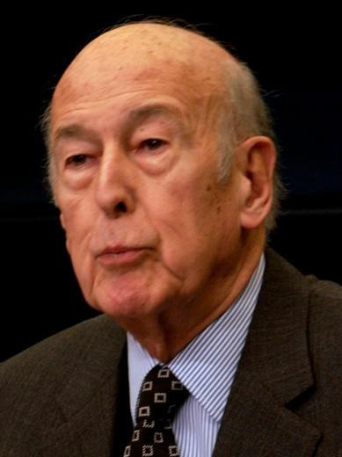
Motivations behind the euro
Goal No. 4 – Keep the Germans under control
Ex-President Giscard d’Estaing: We need an organised Europe to prevent German domination’

Slide 21
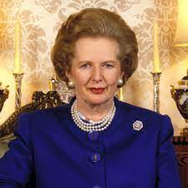
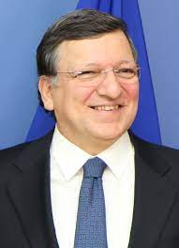
Motivations behind the euro
Goal No. 5 – Make Europe great again
‘It’s the job of business to take the opportunities of a single market with direct unhindered access to over 300m of the world’s most prosperous people. Bigger than Japan. Bigger than the US. On your doorstep. And with the Channel Tunnel for direct access. It's not a dream. It's not a vision. It's not some bureaucrat's plan. It's for real, in only five years.’
– Margaret Thatcher, British Prime Minister (1979-90), 1998
‘Europe 2020 is about more jobs and better lives. Europe can deliver smart, sustainable and inclusive growth, create new jobs and offer a sense of direction to our societies. We have a talented workforce, a powerful technological and industrial base, an internal market and a single currency. We must have confidence to set an ambitious agenda.’
- José Manuel Barroso, European Commission President (2004-14), 2010
+

Slide 22
III. CEE , UK and Germany compared

Slide 23
Mixed picture for Europe amid Ukraine crisis
British EU exit has hit both UK and European performamce
Sharp growth slowdown, no full-scale recession
European convergence improves since 2004
2022 inflation peak, 23-24 normalisation forecast
Long spell of interest rate convergence until 2022
Current account balances deteriorate since 2016
Central banks’ need for higher currency reserves
Germany net creditor strength, UK large debtor
Export performances closely aligned

Slide 24



Sharp growth slowdown, no full-scale recession
GDP growth: European economic performance converging
Annual %. Source: Refinitiv Eikon Datastream, IMF World Economic Outlook, OMFIF analysis. Dashed lines indicate IMF forecast.

Slide 25
European convergence improves since 2004
Non-EMU UK matching CEE development pattern
EMU starts
EU enlargement
Transatlantic Financial Crisis
Brexit referendum
Covid-19 starts
GDP growth: UK moves in lock-step with CEE
Annual change, %. Source: Refinitiv Eikon Datastream, national statistical offices, OMFIF analysis.

Slide 26
2022 inflation peak, 23-24 normalisation forecast
Consumer price inflation: 2022 spike, projected reversion
Annual % change. Source: Refinitiv Eikon Datastream, national sources, IMF, OMFIF analysis. Dashed lines indicate IMF forecast.

Slide 27
Long spell of interest rate convergence until 2022
EMU starts
EMU starts
Transatlantic Financial Crisis
EU enlargement
Transatlantic Financial Crisis
EU enlargement
Covid-19 starts
Brexit referendum
Covid-19 starts
Brexit referendum
Central policy rate: Non-EMU states’ German-style stability
Quarterly, %. Source: Refinitiv Eikon Datastream, national statistical offices, OMFIF analysis

Slide 28
Hungary outlier in bond yield moves
EMU starts
EU enlargement
Transatlantic Financial Crisis
Brexit referendum
Covid-19 starts
10-year government bond yield: 30-year bull market
Annual average, %. Source: Refinitiv Eikon Datastream, national statistical offices, OMFIF analysis

Slide 29
Current account balances deteriorate since 2016
EMU starts
EU enlargement
Transatlantic Financial Crisis
Brexit referendum
Covid-19 starts
Germany’s massive surpluses start to decline
% of GDP. Source: Refinitiv Eikon Datastream, IMF, OMFIF analysis.

Slide 30
Central banks require higher currency reserves
EMU starts
EU enlargement
Transatlantic Financial Crisis
Brexit referendum
Covid-19 starts
Foreign exchange reserves: prolonged rise until 2022
All components, $bn. Source: Refinitiv Eikon Datastream, IMF, national central banks, OMFIF analysis

Slide 31
Tight labour markets across Europe
Unemployment: Phillips curve changed post 2007-08 crisis
% of labour force. New ILO standard. Source: Refinitiv Eikon Datastream, IMF World Economic Outlook, OMFIF analysis

Slide 32
Poland’s employment gains since EU accession
EMU starts
Transatlantic Financial Crisis
EU Enlargement
Transatlantic Financial Crisis
EU enlargement
Covid-19 starts
Brexit referendum
Covid-19 starts
Brexit referendum
Unemployment rate
% (new ILO standard) Source: Refinitiv Eikon Datastream, OECD, national statistical offices, OMFIF analysis.

Slide 33
Germany net creditor strength, UK large debtor
EMU starts
EU enlargement
Transatlantic Financial Crisis
Brexit referendum
Covid-19 starts
Net international investment position: Sharp UK deterioration
End-year, $m. Source: Refinitiv Eikon Datastream, OECD, national statistical offices.

Slide 34
Poland maintains currency stability in real terms
EMU starts
EU enlargement
Transatlantic Financial Crisis
Covid-19 starts
EU Enlargement
Brexit referendum
Real effective exchange rate: Germany gains competitiveness
CPI-based deflator. Index: 2015=100. Source: Refinitiv Eikon Datastream, OECD. 2022 figures latest available

Slide 35
Productivity changes harmonised across Europe
EMU starts
EU enlargement
Transatlantic Financial Crisis
Brexit referendum
Covid-19 starts
Labour productivity: Strength of Europe-wide trends
Annual change, %. Source: Refinitiv Eikon Datastream, OECD.

Slide 36
Export performances closely aligned
EMU starts
EU enlargement
Transatlantic Financial Crisis
Brexit referendum
Covid-19 starts
Exports by volume: 2004 EU widening brings convergence
Annual changes, %. Source: Refinitiv Eikon Datastream, OECD, national statistical offices, OMFIF analysis

Slide 37
Import propensity sharply affected by crises
EMU starts
Transatlantic Financial Crisis
EU Enlargement
Transatlantic Financial Crisis
EU enlargement
Covid-19 starts
Brexit referendum
Covid-19 starts
Brexit referendum
Imports by volume: post-Covid rebound greater than for exports
Annual change, %. Source: Refinitiv Eikon Datastream, OECD, national statistical offices, OMFIF analysis.

Slide 38
IV. Living with crisis - EMU update

Slide 39

Reality hits home: changing ECB line on inflation
‘Inflation remains far too high and is likely to stay above our target for an extended period.. We expect to raise interest rates further over the next several meetings.’ 26 Sep 2022
‘We are so far away from the rate that will help us return inflation to 2% that our hikes have to be not only timely but of a magnitude that brings us closer to those rates.’ 8 Sep 2022
‘We decided to go for 50 basis points hike in July, therefore, the combined forward guidance that existed for September is no longer applicable.’ 21 Jul 2022
‘’We intend to raise the key ECB interest rates by 25 bp at our July meeting.’ 9 Jun 2022
‘Inflation has increased significantly and will remain high over coming months.’ 14 Apr 2022
‘Any adjustments to the key ECB interest rates will take place some time after the end of our net purchases …and will be gradual.’ 10 Mar 2022
‘Euro area demand conditions do not show same signs of overheating … This increases the likelihood price pressures will subside before becoming entrenched.’ 7 Feb 2022
‘Inflation will fall less than we all had all envisaged a year ago, but it will fall.’ 20 Jan 2022
‘Under present circumstances, it is very unlikely that we will raise interest rates in the year 2022. But we have to be very attentive to what data tells us.’ 17 Dec2021
‘I see an inflation profile [as] a hump [which] eventually declines… 55%-60% of inflation is from energy prices… By end-2022 it will have declined significantly.’ 3 Dec 2021
Christine Lagarde, ECB President (2019- )

Slide 40
CZECHIA
 | 2014 | 2015 | 2016 | 2017 | 2018 | 2019 | 2020 | 2021 | 2022f | 2023f
Real GDP (% change) | 2.3 | 5.4 | 2.5 | 5.2 | 3.2 | 3.0 | -5.5 | 3.5 | 1.9 | 1.5
GDP/capita ($ ‘000) | 19.9 | 17.8 | 18.6 | 20.7 | 23.5 | 23.7 | 23.0 | 26.8 | 28.0 | 29.9
Consumer price inflation (%) | 0.3 | 0.3 | 0.7 | 2.5 | 2.1 | 2.9 | 3.2 | 3.8 | 16.3 | 8.6
Unemployment (%) | 6.1 | 5.0 | 3.9 | 2.9 | 2.2 | 2.0 | 2.5 | 2.8 | 2.5 | 2.3
General government budget balance (% of GDP) | -2.1 | -0.6 | 0.7 | 1.5 | 0.9 | 0.3 | -5.8 | -5.9 | -4.0 | -3.3
General government gross debt (% of GDP) | 41.9 | 40.0 | 36.6 | 34.2 | 32.1 | 30.0 | 37.6 | 42.0 | 41.5 | 41.2
Current account balance (% of GDP) | 0.2 | 0.5 | 1.8 | 1.5 | 0.4 | 0.3 | 2.0 | -0.9 | -4.3 | -2.2
Source: IMF October 2022 WEO. Red / green: under- /outperformance cf. euro area; amber: equal scores
No comparisons for GDP/capita due to difficulties of aligning data with exchange rates and PPP calculations

Slide 41
HUNGARY
 | 2014 | 2015 | 2016 | 2017 | 2018 | 2019 | 2020 | 2021 | 2022f | 2023f
Real GDP (% change) | 4.3 | 3.8 | 2.3 | 4.3 | 5.4 | 4.6 | -4.5 | 7.1 | 5.7 | 1.8
GDP/capita ($ ‘000) | 14.2 | 12.7 | 13.1 | 14.6 | 16.4 | `6.7 | 16.0 | 18.7 | 19.0 | 20.2
Consumer price inflation (%) | -0.2 | -0.1 | 0.4 | 2.4 | 2.8 | 3.4 | 3.3 | 5.1 | 13.9 | 13.3
Unemployment (%) | 7.5 | 6.6 | 5.0 | 4.1 | 3.6 | 3.3 | 4.1 | 4.1 | 3.4 | 3.8
General government budget balance (% of GDP) | -2.8 | -2.0 | -1.8 | -2.5 | -2.1 | -2.1 | -7.8 | -6.8 | -4.9 | -3.1
General government gross debt (% of GDP) | 76.7 | 75.8 | 74.8 | 72.1 | 69.1 | 65.5 | 79.6 | 76.8 | 74.8 | 73.9
Current account balance (% of GDP) | 1.2 | 2.3 | 4.9 | 2.0 | 0.2 | -0.7 | -1.1 | -3.2 | -6.7 | -3.0
Source: IMF October 2022 WEO. Red / green: under- /outperformance cf. euro area; amber: equal scores
No comparisons for GDP/capita due to difficulties of aligning data with exchange rates and PPP calculations

Slide 42
GERMANY
 | 2014 | 2015 | 2016 | 2017 | 2018 | 2019 | 2020 | 2021 | 2022f | 2023f
Real GDP (% change) | 2.2 | 1.5 | 2.2 | 2.7 | 1.0 | 1.1 | -3.7 | 2.6 | 1.5 | -0.3
GDP/capita ($ ‘000) | 48.0 | 41.1 | 42.1 | 44.6 | 48.0 | 46.8 | 46.7 | 51.2 | 48.4 | 49.4
Consumer price inflation (%) | 0.8 | 0.7 | 0.4 | 1.7 | 1.9 | 1.4 | 0.4 | 3.2 | 8.4 | 7.2
Unemployment (%) | 4.7 | 4.4 | 3.9 | 3.6 | 3.2 | 3.0 | 3.6 | 3.6 | 2.9 | 3.4
General government budget balance (% of GDP) | 0.6 | 1.0 | 1.2 | 1.3 | 2.0 | 1.5 | -4.3 | -3.7 | -3.3 | -2.5
General government gross debt (% of GDP) | 75.3 | 71.9 | 69 | 64.6 | 61.2 | 58.9 | 68.0 | 69.6 | 71.1 | 68.3
Current account balance (% of GDP) | 7.2 | 8.6 | 8.5 | 7.8 | 8.0 | 7.6 | 7.0 | 7.4 | 4.2 | 5.3
Source: IMF October 2022 WEO. Red / green: under- /outperformance cf. euro area; amber: equal scores
No comparisons for GDP/capita due to difficulties of aligning data with exchange rates and PPP calculations

Slide 43

UK
 | 2014 | 2015 | 2016 | 2017 | 2018 | 2019 | 2020 | 2021 | 2022f | 2023f
Real GDP (% change) | 3.0 | 2.6 | 2.3 | 2.1 | 1.7 | 1.7 | -9.3 | 7.4 | 3.6 | 0.3
GDP/capita ($ ‘000) | 47.8 | 45.4 | 41.6 | 40.9 | 43.7 | 43.1 | 41.1 | 47.3 | 47.3 | 51.3
Consumer price inflation (%) | 1.5 | 0.0 | 0.7 | 2.7 | 2.5 | 1.8 | 0.9 | 2.6 | 9.1 | 9.0
Unemployment (%) | 6.2 | 5.4 | 4.9 | 4.4 | 4.1 | 3.8 | 4.6 | 4.5 | 3.8 | 4.8
General government budget balance (% of GDP) | -5.5 | -4.5 | -3.3 | -2.4 | -2.2 | -2.2 | -12.8 | -8.0 | -4.3 | -2.3
General government gross debt (% of GDP) | 85.4 | 86.0 | 85.8 | 85.1 | 84.5 | 83.9 | 102.6 | 95.3 | 86.7 | 79.9
Current account balance (% of GDP) | -5.1 | -5.2 | -5.3 | -3.6 | -3.9 | -2.7 | -2.5 | -2.6 | -4.8 | -4.5
Source: IMF October 2022 WEO. Red / green: under- /outperformance cf. euro area; amber: equal scores
No comparisons for GDP/capita due to difficulties of aligning data with exchange rates and PPP calculations
NARODOWY
BANK POLSKI

Slide 44

EURO AREA
 | 2014 | 2015 | 2016 | 2017 | 2018 | 2019 | 2020 | 2021 | 2022f | 2023f
Real GDP (% change) | 1.4 | 2.0 | 1.9 | 2.6 | 1.8 | 1.6 | -6.1 | 5.2 | 3.1 | 0.5
Consumer price inflation (%) | 0.4 | 0.2 | 0.2 | 1.5 | 1.8 | 1.2 | 0.3 | 2.6 | 8.3 | 5.7
Unemployment (%) | 11.7 | 10.9 | 10.1 | 9.1 | 8.2 | 7.6 | 8.0 | 7.7 | 6.8 | 7.0
General government budget balance (% of GDP) | -2.5 | -2.0 | -1.5 | -0.9 | -0.5 | -0.7 | -7.0 | -5.1 | -3.8 | -3.3
General government gross debt (% of GDP) | 93.1 | 91.2 | 90.4 | 87.9 | 85.9 | 83.8 | 96.9 | 95.3 | 92.3 | 91.3
Current account balance (% of GDP) | 2.3 | 2.7 | 3.0 | 3.2 | 2.9 | 2.3 | 1.9 | 2.5 | 1.0 | 1.4
Source: IMF; data in 2022-23 are forecasts

Slide 45
Steady rise in Bund spreads in 2022 – UK outlier
Italy election
Russia invades Ukraine
End net PEPP purchases
TPI announcement
TPI details
UK ‘mini’ budget
10-year government yield spread over German bonds
Basis points. Source: Refinitiv Eikon Datastream, IMF, OMFIF analysis.

Slide 46
Big spread deterioration for Hungary and Poland in 2022
Italy election
Russia invades Ukraine
End net PEPP purchases
TPI announcement
TPI details
UK ‘mini’ budget
10-year government yield spread over German bonds
Basis points. Source: Refinitiv Eikon Datastream, IMF, OMFIF analysis.

Slide 47
Big decline in ECB Italy support since summer
Eurosystem ECB programmes public sector net purchases
Monthly averages, $bn. Source: ECB, IMF, OMFIF analysis. Ashok Bhjatia 5.10.22 Paris slides

Slide 48
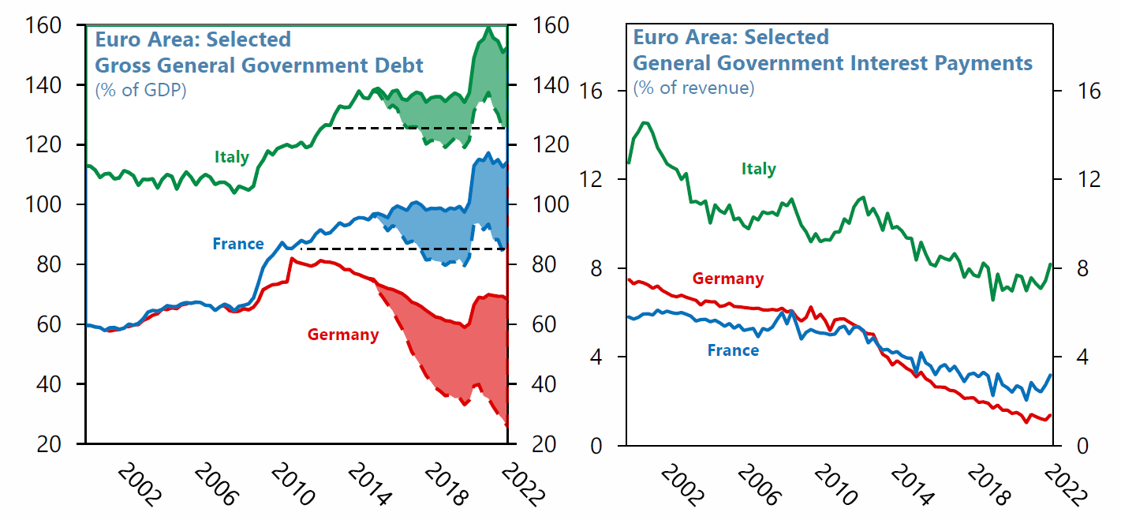
EMU debt service costs rise as ECB funding fades
Euro government funding – ECB bond buying cuts debt costs
Shaded area – Eurosystem holdings excl. SMP. Source: IMF based on ECB figures – Ashok Bhatia 5.10.22 Paris slides

Slide 49
V. Precepts for the future

Slide 50
Suggested guidelines for Polish policy
Maintain tight monetary policies despite recession risks
Back government on energy saving and other measures
Support fiscal-monetary coordination, but emphasise ‘orthodoxy’
Maintain maximum alignment with US in politics and economics
Prioritise efforts to minimise Bund spreads (600 bp is far too high)
Step up investment promotion / bond market investor relations
Explore new issuance techniques including ‘green’ T-bills
Secure adequate foreign exchange and gold reserves
Work on relations with ECB and other major central banks
Explore technical moves including swap lines, repo measures
Keep EMU door open, but underline no interest in adventurism

Slide 51
Acknowledgments
Thanks are due to Taylor Pearce, Nikhil Sanghani, Katerina Liu for the compilation of this presentation
Thanks also to Ashok Bhatia for permission to use two IMF slides authored by him first displayed at the OMFIF conference ‘Future of the euro area’ in Paris on 5 October.
For further references please contact : emma.jones@omfif.org, paul.grace@omfif.org

